Slide 1
Group 7
Stefan, Joachim, Weronika, Emil, Gergö

Slide 2
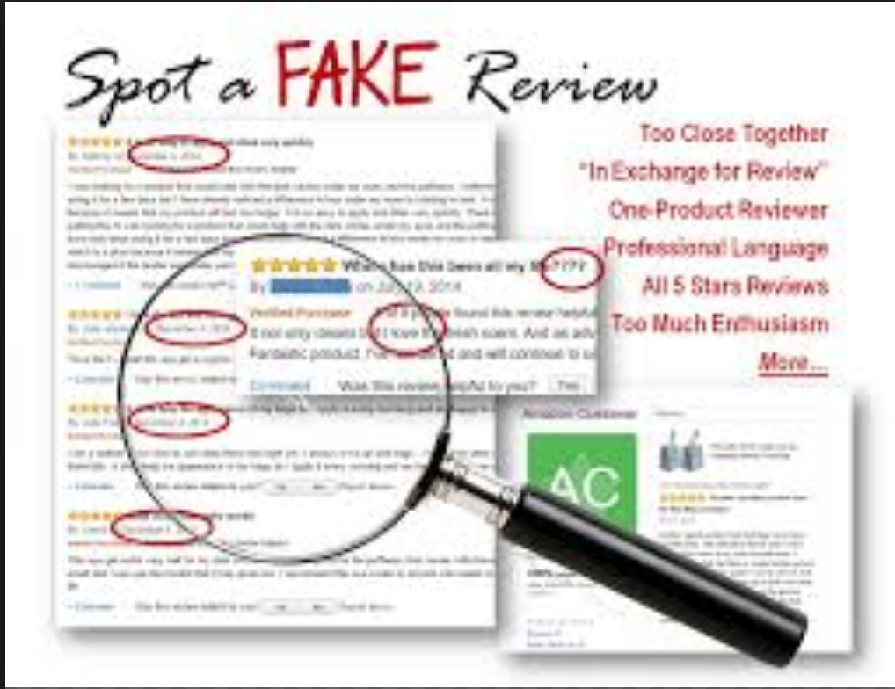
Idea 1: Amazon Reviews
Question: Evaluting precision of detecting good/bad reviews
Sub question: Can we detect fake reviews?
Data: 6 million reviews (10 billion words) (Bing Liu, UIC)
Exploratory analysis: Membership info – Location, names, amount of reviews, IP address, rating they gave reviews (We have the answer key)
Expected results: Precise predictions (match ratings to categorization)
Sentiment analysis, n-grams, sentence structure, pos tagging?
Problems: Can not fit within project description (Is ok, Leon?)

Slide 3

Idea 2: Music
Are lyrics gender specific?
Can we match songs to genres by lyrics?
Which genres uses what words?
Has vocabulary increased/decreased? (n-grams by year)
No data yet collected
EDA: Not conducted yet
Expected results: Decrease of information in n-grams by year
Problems: Max Martin factor?
Further ideas: lyrics related to documented confrontation
with law or mental issues?

Slide 4

Idea 3: Presidential speeches
Categorizing speeches by political party
Sub-question: Spot increase/decrease in LIX number?
First lady speeches?
Data: We scraped all presidential inauguration speeches (989 speeches, 4 mil words)
Exploratory: Not done yet
Expectation: LIX level drop by century?
Methods: n-grams, LDA?, tf-idf, so on

Slide 5
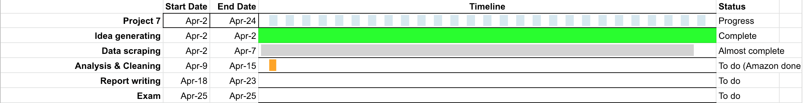
Gant Chart

